Slide 1

Learning Objectives
Organisation as a function of management
Models of organisational change
Theoretical foundations of change management
Lewin’s planned approach to change
Emergent approach to change
Role of change agent

Slide 2

Organising as a function of Management
Organising is the function of management which follows planning
It is a function in which the synchronization and combination of human, physical and financial resources takes place
Barnard (1948), “Organising is a function by which the concern is able to define the role positions, the jobs related and the co-ordination between authority and responsibility. Hence, a manager always has to organise in order to get results.”
Albert Einstein "If a cluttered desk is a sign of a cluttered mind, of what, then, is an empty desk a sign?

Slide 3

Organising as a function of Management
Identification of activities
Departmentally organising the activities
Classifying authority
Co-ordination between authority and responsibility

Slide 4
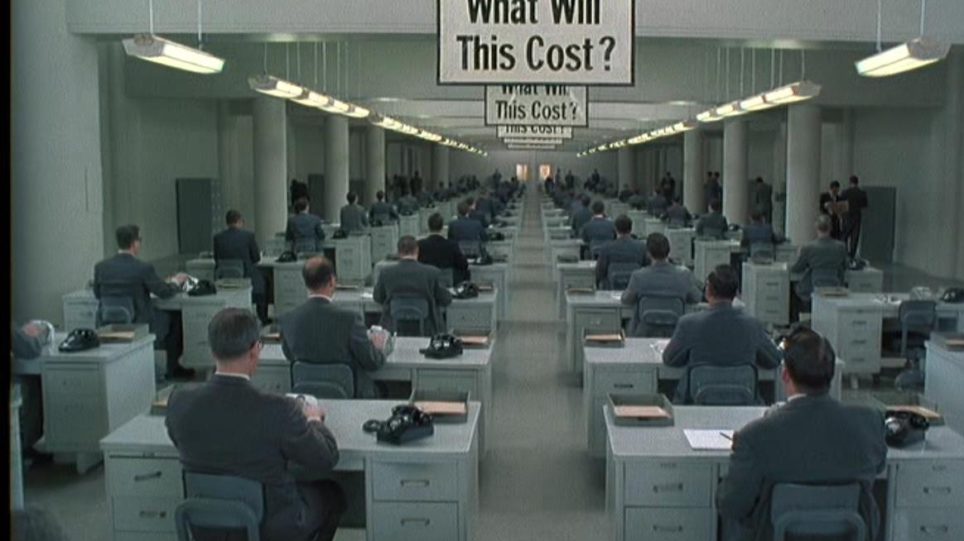
Identification of Activities
Identification of activities e.g. preparation of accounts, making sales, record keeping, quality control, inventory control, etc.
All these activities have to be grouped and classified into units
The Hudsucker Proxy (1994) Cohen Brothers

Slide 5

Departmentally organising the activities
The manager tries to combine and group similar and related activities into units or departments
This organisation of dividing the whole concern into independent units and departments is called departmentation

Slide 6
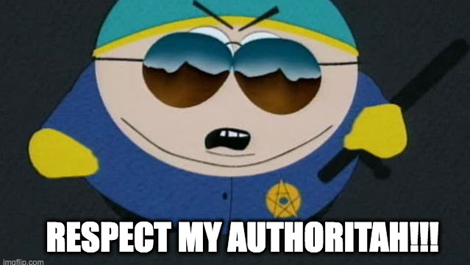
Authority Classification
The formation of departments - classifies the scope of responsibility to the managers (and all stakeholders)
This activity of giving a rank in order to the managerial positions is called hierarchy
The clarification of authority brings efficiency to the running of the firm
Concerned with efficiency – e.g. avoiding wastage of time, money, effort, in avoidance of duplication or overlapping of effort

Slide 7
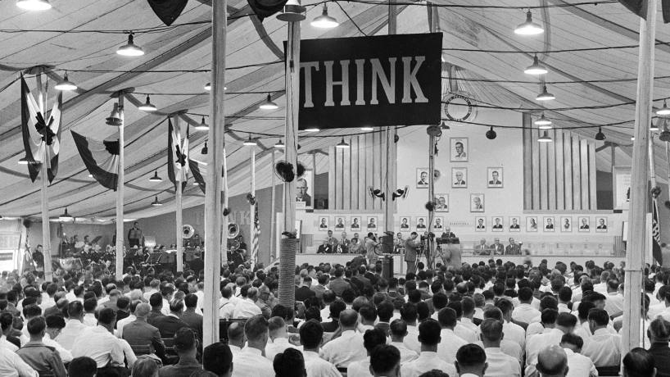
Co-ordination between Authority & Responsibility
Relationships are established among various groups to enable smooth interaction toward achievement of the organisational goals
Each individual is made aware of their authority and whom they have to take orders from and to whom they are accountable and to whom they have to report
A clear organisational structure is drawn and all the employees are made aware of it

Slide 8
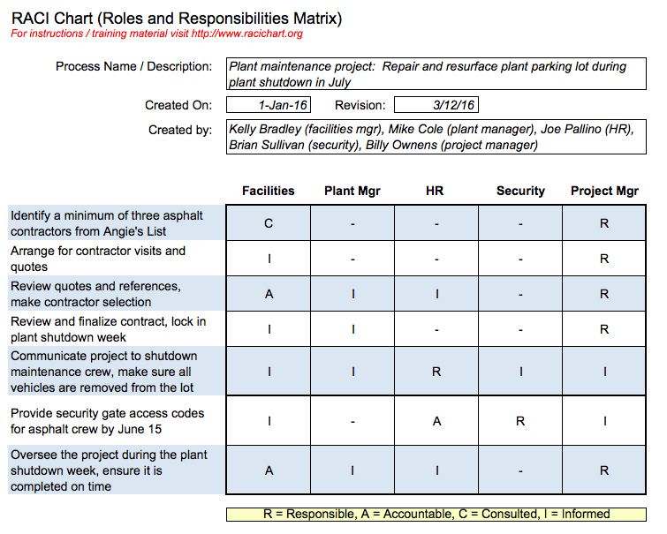
RACI
An acronym for;
    Responsible
    Accountable
    Consulted
    Informed
A RACI chart is a matrix of all the activities or decision making authorities undertaken in an organisation set against all the people or roles
Imagine Source: https://racichart.org/

Slide 9

The Need for Development
Changing nature of the workforce
Rapidly changing technology
Economic changes
Changes in social trends
Strategic Imperative

Slide 10

Organisational Development
Organisational wide
Planned intervention
Managed from the top
Aimed at increasing an organisation’s health & effectiveness
Uses behavioural science knowledge

Slide 11
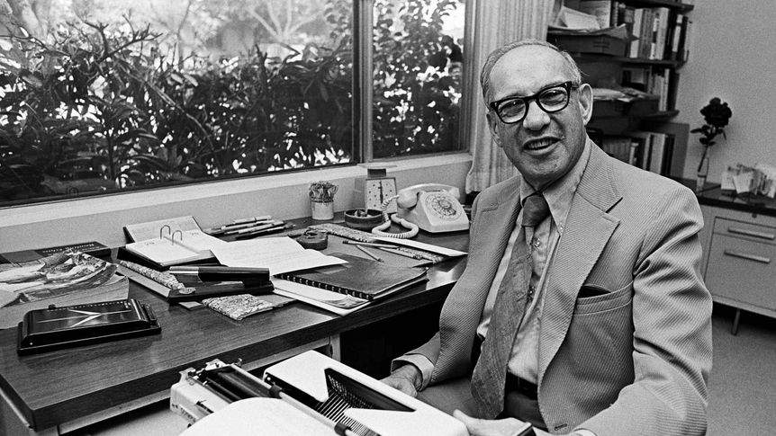
Organisational Health
Anticipating the need for change
“No century in recorded history has experienced so many social transformations and such radical ones as the twentieth century. They, I submit, may turn out to be the most significant events of this, our century, and its lasting legacy. In the developed free-market countries—which contain less than a fifth of the earth's population but are a model for the rest—work and work force, society and polity, are all, in the last decade of this century, qualitatively and quantitatively different not only from what they were in the first years of this century but also from what has existed at any time in history: in their configurations, in their processes, in their problems, and in their structures. Drucker (1994) “The Age of Social Transformation"

Slide 12
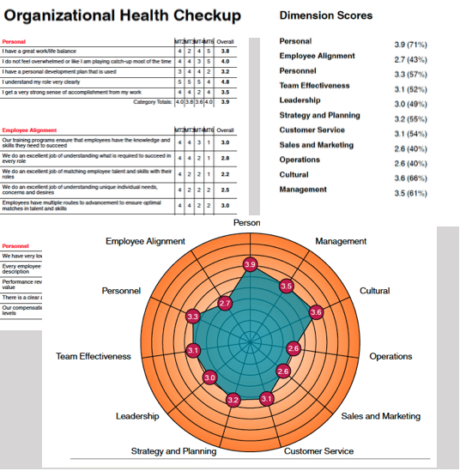
Organisational Health
“A theory of the growth of firms is essentially an examination of the changing productive opportunity of firms; in order to find a limit to growth, or a restriction on the rate of growth, the productive opportunity of a firm must be shown to be limited in any period.” Penrose ([1959], 1995)
It may be that the firm has reached optimum size for its market or attained the horizon set by the entrepreneur and is ‘subject to the inertia of success’.
https://www.soarinstitute.co.za/organizational-health-check/

Slide 13

Organisational Health
The ability of an organisation to function effectively
Traditionally, when organisations show a good financial performance they were regarded healthy
However, several writers have argued about the insufficiency (ability) of the accounting-based financial measurement system to measure the health of organisations
According to Saunders and Barker (2001), financial analysis tends to measure consequences of organisational factors and events or circumstances and supported for the examination of those organisation factors

Slide 14
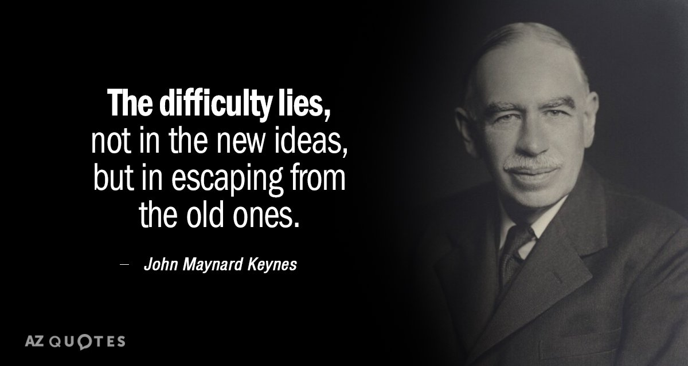

Slide 15
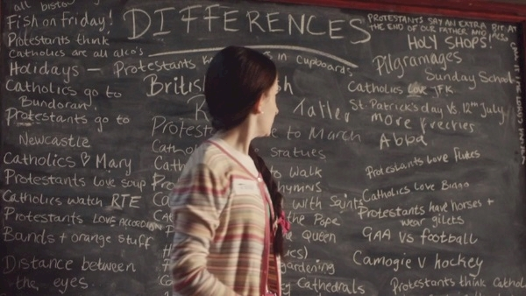
Derry Girls - Season 2 | The Difference Between Catholics And Protestants https://www.youtube.com/watch?v=B4O-nOI-6Qg

Slide 16

What is the Organisation?
Is it a living entity ?
Is it a machine for making money?

Slide 17
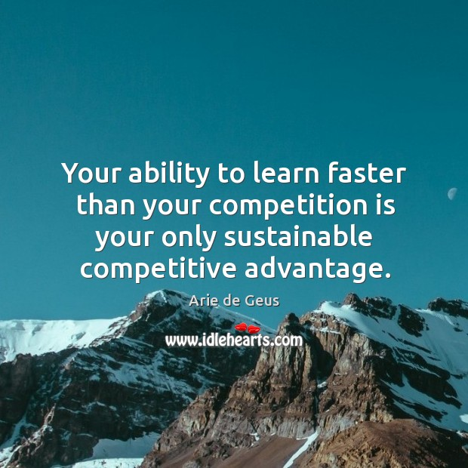
Healthy Organisations
What constitutes a ‘healthy’ organisation?
Recognizing and understanding the characteristics of healthy organisations can help detect problems in the business, for example if it is unprofitable and take corrective steps to operate a successful business

Slide 18


Healthy Organisations
According to DeGeus (2007) The ancient Chinese characters for business, at least 3000 years old, translate as ‘Life’ or ‘Live’ , the second translates as ‘Meaning’
Workers experience corporate health not in terms of corporate life expectancy but as;
    Work stress
    Endless struggles for power and control
    Cynicism and resignation
    Work environment that stifles rather than releases human potential
https://www.chinese-word.com/keyword/keyword-m.html

Slide 19
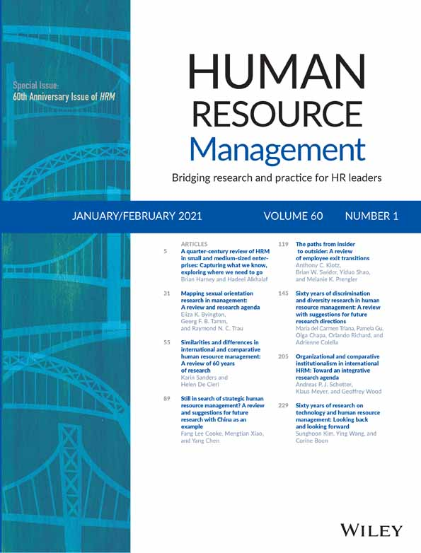
Pfeffer (1988)
Seven People Centred Practices
Job security (to eliminate fear of lay-offs)
Careful hiring (emphasizing a good fit with company culture)
Power to the people (via decentralization and self-managed teams)
Generous pay for performance
Lots of training
Less emphasis on status (to build a ‘we’ feeling)
Trust building (through the sharing of critical information)

Slide 20
The 4-P Cycle of Continuous Improvement
Organizational Health
People
Skill development
Motivation
Teamwork
Personal development & learning
Readiness to change & adapt
Increased personal responsibility for organisational outcomes
Greater self-management
Decreased stress
Products
Better quality goods & services
Greater customer satisfaction
Job creation
Processes
Technological advancement
Faster product development & production cycle times
Systems flexibility
Leaner & more effective administration
Improved communication & information flow
Organisational learning
Participative & ethical decision making
Productivity
Reduced waste
Reduced rework
More efficient use of material, human, financial & informational resources

Slide 21

Defining the Living Company
(De Geus’ Four Factors)
Sensitivity to the environment represents a company’s ability to learn and adapt
Cohesion and identity, it is now clear, are aspects of a company’s innate ability to build a community and a persona for itself
Tolerance and its corollary, decentralization, are both symptoms of a company’s awareness of ecology: its ability to build constructive relationships with other entities, within and outside itself
Conservative financing as one element in a very critical corporate attribute: the ability to govern its own growth and evolution effectively

Slide 22
The Living Company
Effective Sharing of Goals
Shares its business goals with employees at every level of the organisation
Management shares goals with employees and gets them on board with the mission and vision of the organisation
Employees and managers understand what is required to reach these shared goals and make every effort to achieve them
High Employee Morale
Possess high employee morale
Employees value their positions in the organisations and desire to work there for a long time
High productivity and organisational events are enjoyable and successful
Offers Training Opportunities
Provide on-the-job training and opportunities for employees to enhance their work-related skills
Use external trainers if necessary to provide necessary departmental and corporate-wide training
Offer opportunities to pursue certification and continual education

Slide 23
The Living Company
Handles Poor Performance
Confront poor performance rather than ignoring it
Take corrective actions to improve performance
Upper-level management values the input of employees on how to improve productivity and achieve high performance rates
Willingness to use external specialists to detect problems and offer solutions
Understands Risks
Understand the risks they are open to and take the necessary steps to protect themselves against them
When an event happens due to organisational risks, a healthy organization learns from the event
Use precaution but understand that risks are necessary to facilitate growth
Great Teamwork
Know how to develop teams that collaborate to achieve common goals
Employees and managers readily offer their assistance to each other to meet corporate objectives

Slide 24
The Living Company
Clearly Defined Structure
Possess a sense of order and organizational structure
The structure and order of the organization does not limit innovation and growth
Employees comply with the company's order and structure because they understand it and see the benefits of its implementation
Well-Known Company Policies
Create and implement company policies that are readily available to their employees
Follow the policies and regulations laid down by local council, government, and EU
When employees or managers break policies, the issue is dealt with immediately and in a professional manner
Adapts to Opportunities & Changes
Healthy organizations know how to recognize and seize good opportunities
Healthy organizations always look for opportunities to grow
Healthy organizations know how to adapt to technological or operational changes
They try to stay ahead or inline with changes in the industry and business environment
Strong Leadership
One of the main characteristics of a healthy organisation
Employees have good relationships with management that are based on trust
Managers know how to get employees to function together
When correction is needed, employees readily accept the constructive criticism offered by leaders

Slide 25
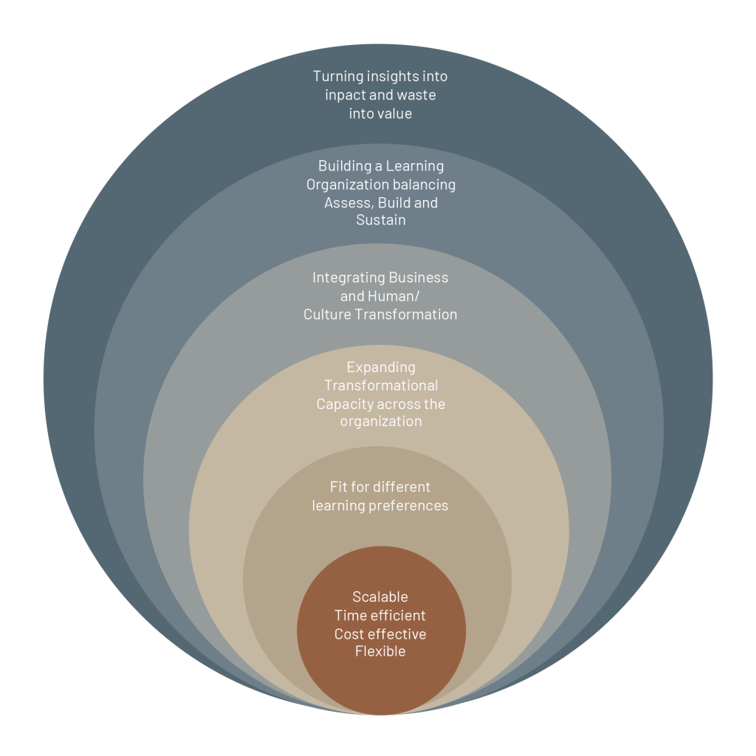
Organisational Health
Mezirow et al (2009:95) highlight the need “for more clarification and emphasis on the role played by emotions, intuition and imagination in the process of transformation.”
This is because the process of transformative learning requires the learner to “critically assess and validate” their assumptions
Does this have a bearing on the organisation?
Graphic Source: https://breathingbusiness.com/school-of-transformation/Health

Slide 26

Organisational Development
Organisational development (OD) is an important element in effective growth & longevity
The process used to improve the overall effectiveness of an organisation through managing the behaviours of people within that organisation
Important to have the systems in place to allow change to be implemented & planned effectively & that analyse real data, which can then be used to implement further change
Definition of OD is determined by the business. For example,
    HSE the purpose of OD is to improve the safety & quality of patient care
    An accountancy firm the purpose of OD might be to improve efficiency of processes & quality of client contact

Slide 27
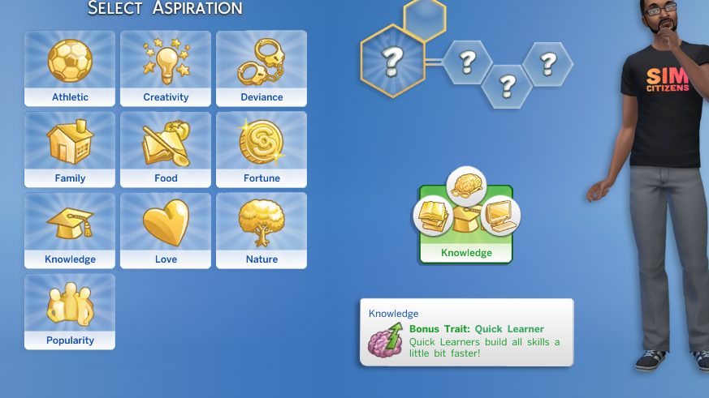
Common Traits
Makes changes to the strategy, structure or process of an entire system of an organisation, department, work group, individual role or job
Manages planned change in a flexible way to allow further change in the future as new information becomes available
Institutionalises change to reinforce change
Improves organisational effectiveness

Slide 28
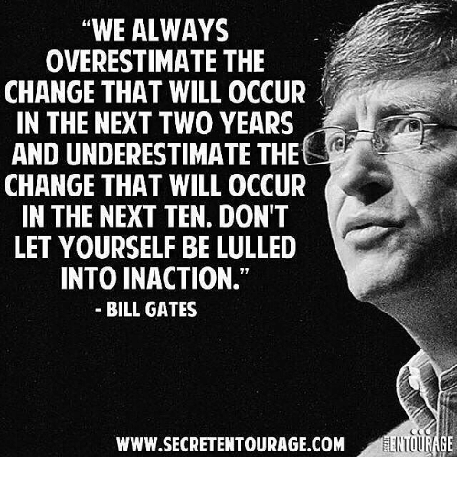
Nature of Organisational Change
Change is inevitable for organisations in order to ensure success and perhaps survival
There are claims that approximately 70% of change initiatives fail
Yet, there lacks ‘a valid framework of how to implement and manage organisational change’ (By, 2005: 370)
Change can comprise:
  New projects/initiatives
  Process changes
  Cultural changes (Ulrich, 1997)
McKinsey on Change Management
  https://www.youtube.com/watch?v=k69i_yAhEcQ

Slide 29
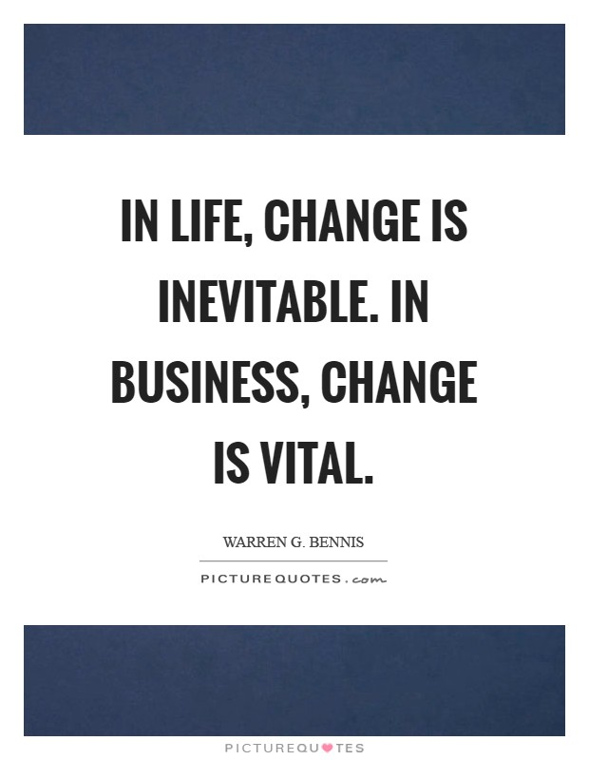
Organisation Development (OD)
Organisation development “OD” defined by Rowlandson (1984) as ‘an intervention strategy that uses group processes to focus on the whole culture of an organization in order to bring about planned change’.
CIPD (2010) ‘planned and systematic approach to enabling sustained organisation performance through the involvement of its people’.
‘OD has been, and arguably still is, the major approach to change across the western world, and increasingly globally.’ (Burnes and Cooke, 2012)

Slide 30

Organisation Development
Originally based on behavioural science concepts, i.e. the field of enquiry dedicated to the study of human behaviour through sophisticated and rigorous methods
Practised through ‘interventions’ described in OD jargon as planned activities designed to improve organisational effectiveness or manage change
Incorporates more business-focused activities such as smart working and high performance working and involves HR to a much greater extent
1980s and 1990s a number of other approaches were introduced and further changes occurred which more business-focused activities such as smart working and high performance working
Organisation development used to be the province of specialized consultants who tended to practice it as a mystery with HR playing a supporting role if it played any role at all (Armstrong, 2017)
https://soundcloud.com/cipd/podcast-28-organisational-development

Slide 31
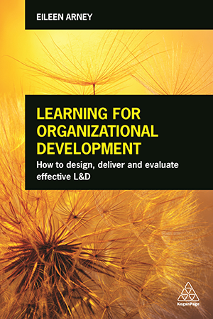
Organisation Development Changes
The main change that has taken place in the move from traditional OD to organisational development as practiced currently is the focus on improving organisational performance and results through organisation-wide initiatives
These organisation-wide initiative encompass the behaviour of people, especially when this relates to their levels of engagement (the degree to which people are committed to their work and the organization and motivated to achieve high levels of performance)
But they are also concerned with the organisational processes that affect behaviour and engagement, namely strategic HRM, work system design, smart working, high performance working, organization design and job design

Slide 32
Organisation Development Trends
Classical Organisational Development (1950s onward) | New Organisational Development (1980s onward)
Based in classical science & modern thought & philosophy | Influenced by the new sciences & postmodern thought & philosophy
Truth is transcendent and discoverable; there is a single, objective reality | Truth is imminent and emerges from the situation; there are multiple, socially constructed realities
Reality can be discovered using rational & analytic processes | Reality is socially negotiated & may involve power & political processes
Collecting & applying valid data using objective problem-solving methods leads to change | Creating new mindsets or social agreements, sometimes through explicit negotiation, leads to change
Change is episodic & created, planned & managed | Change is continuous & can be self-organising
Emphasis on changing behaviour & what one does | Emphasis on changing mindsets & how one thinks

Slide 33
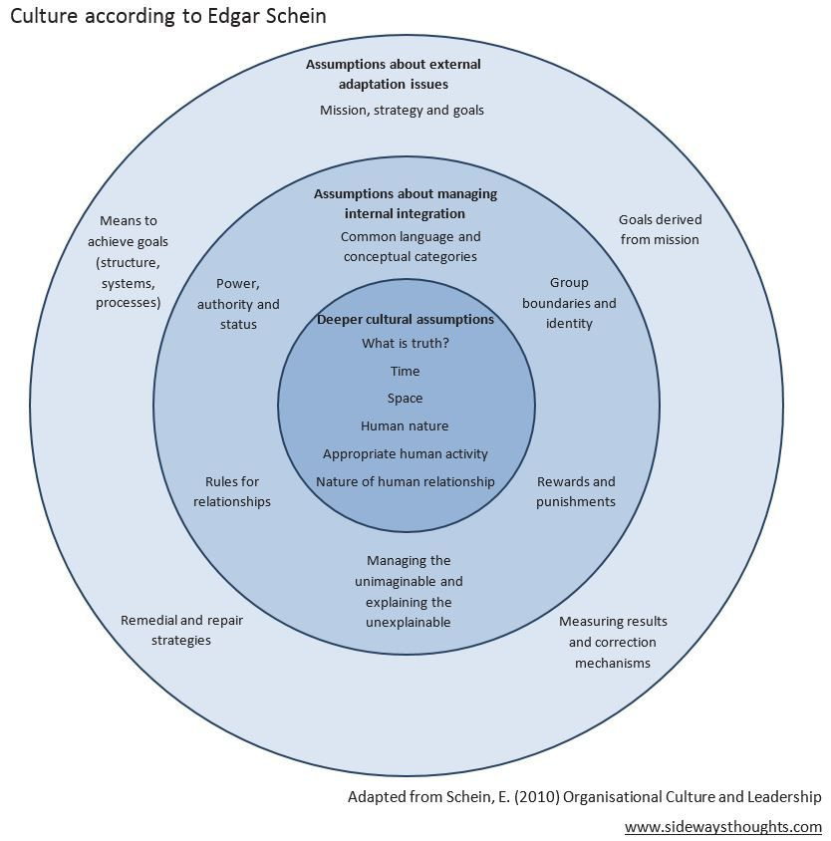
Organisation Development Strategy
Defined by Ulrich & Lake (1990) as ‘the ability to manage people for competitive advantage’
Concerned with mapping out intentions on how the work system should be developed in line with the concept of smart working
How the organisation should be structured to meet new demands, on system-wide change in fields such as reward and performance management
How change should be managed
What needs to be done to improve organisational processes involving people such as teamwork, communications & participation & how the organization can acquire, retain, develop & engage the talent it needs
These intentions are converted into actions on work systems development, structure design, the redesign of jobs &, possibly, OD-type intervention

Slide 34
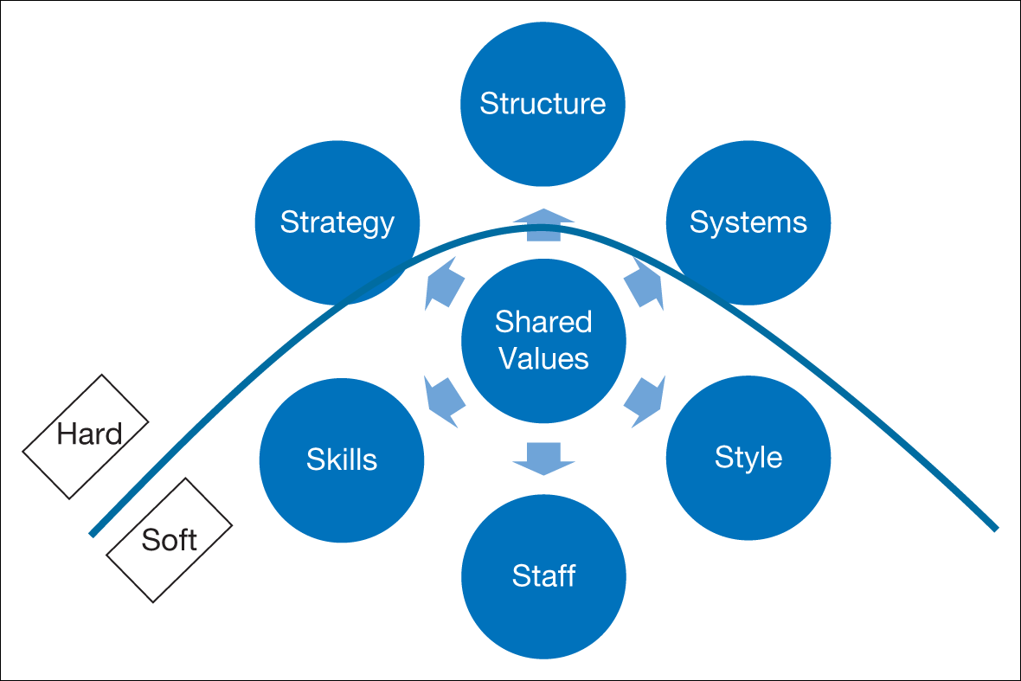
Strategy, Structure and Culture McKinsey’s 7-S model
Source: Adapted from Waterman, Jr., R.H., Peters, T.J. and Phillips, J.R. (1980), ‘Structure is not organization’, Business Horizons, 23, 3: 14.
Notes:
Figure 9.8

Slide 35

Assumptions & Values
Originally Humanism philosophy - the belief that human factors are paramount in the study of organisational behaviour
Focused on the needs of people as individuals and in groups with an emphasis on process – how people worked together and how this could be improved
Assumptions & Values;
    Individuals are driven by the need for personal growth and development as long as their environment is both supportive and challenging
    The work team, especially at the informal level, has great significance for feelings of satisfaction and the dynamics of such teams have a powerful effect on the behaviour of their members
    Organisations can be more effective if they learn to diagnose their own strengths and weaknesses
    Managers often do not know what is wrong and need special help in diagnosing problems, although the outside ‘process consultant’ ensures that decision making remains in the hands of the client

Slide 36
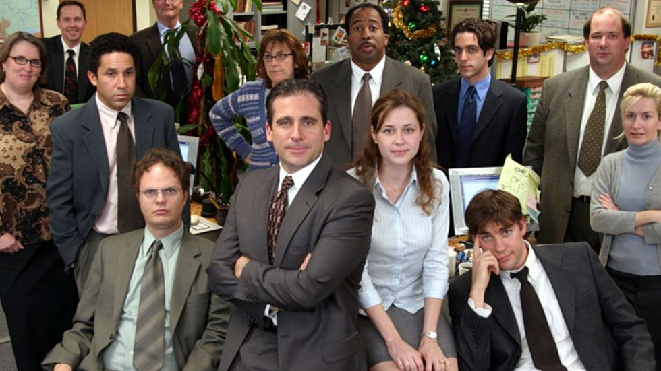
The Office - Managing Change https://www.youtube.com/watch?v=v6XUBSAZQo0

Slide 37
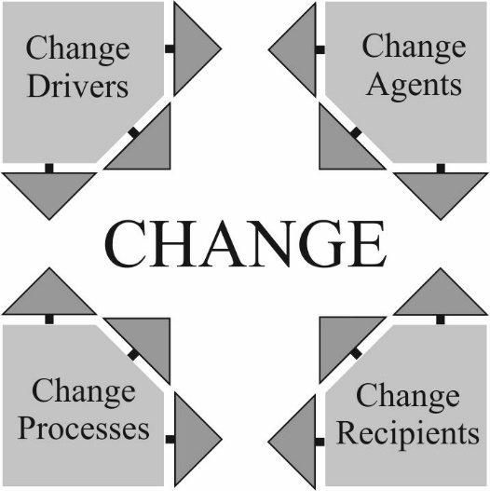
Change Cornerstones

Slide 38
Cornerstone 1: Change Drivers
(‘Why’?) Impact on People
External Drivers of Change
Political
Economic
Socio-cultural
Technology
Internal Drivers of Change
New CEO
Strategic repositioning: flexibility, competitiveness, survival
Changes in HR practices, workforce profile
Cultural transformation
Organisational re-structuring
New products, services
New job designs, new technology

Slide 39
Cornerstone 2: Change Processes
(‘How’?)
Early Approaches
Scientific Management
Human Relations Movement
Lewin’s Three-stage Model
Freezing
Changing
Re-freezing
Organisation Development (OD) (Beckhard, 1969)
Planned
Organisation-wide
Managed from the top
Increase organisation effectiveness and health
Planned interventions in the “organisation’s processes” using behavioral-science knowledge’
Issues
Under-theorized (Buchanan, 2003)
Lack strong evidence base (By, 2005)
Fail to account for context or culture (Fitzgerald et al., 2006)
Focus on planned rather than emergent change (Burnes, 2004)
Stages are too linear (Loveday, 1984)

Slide 40
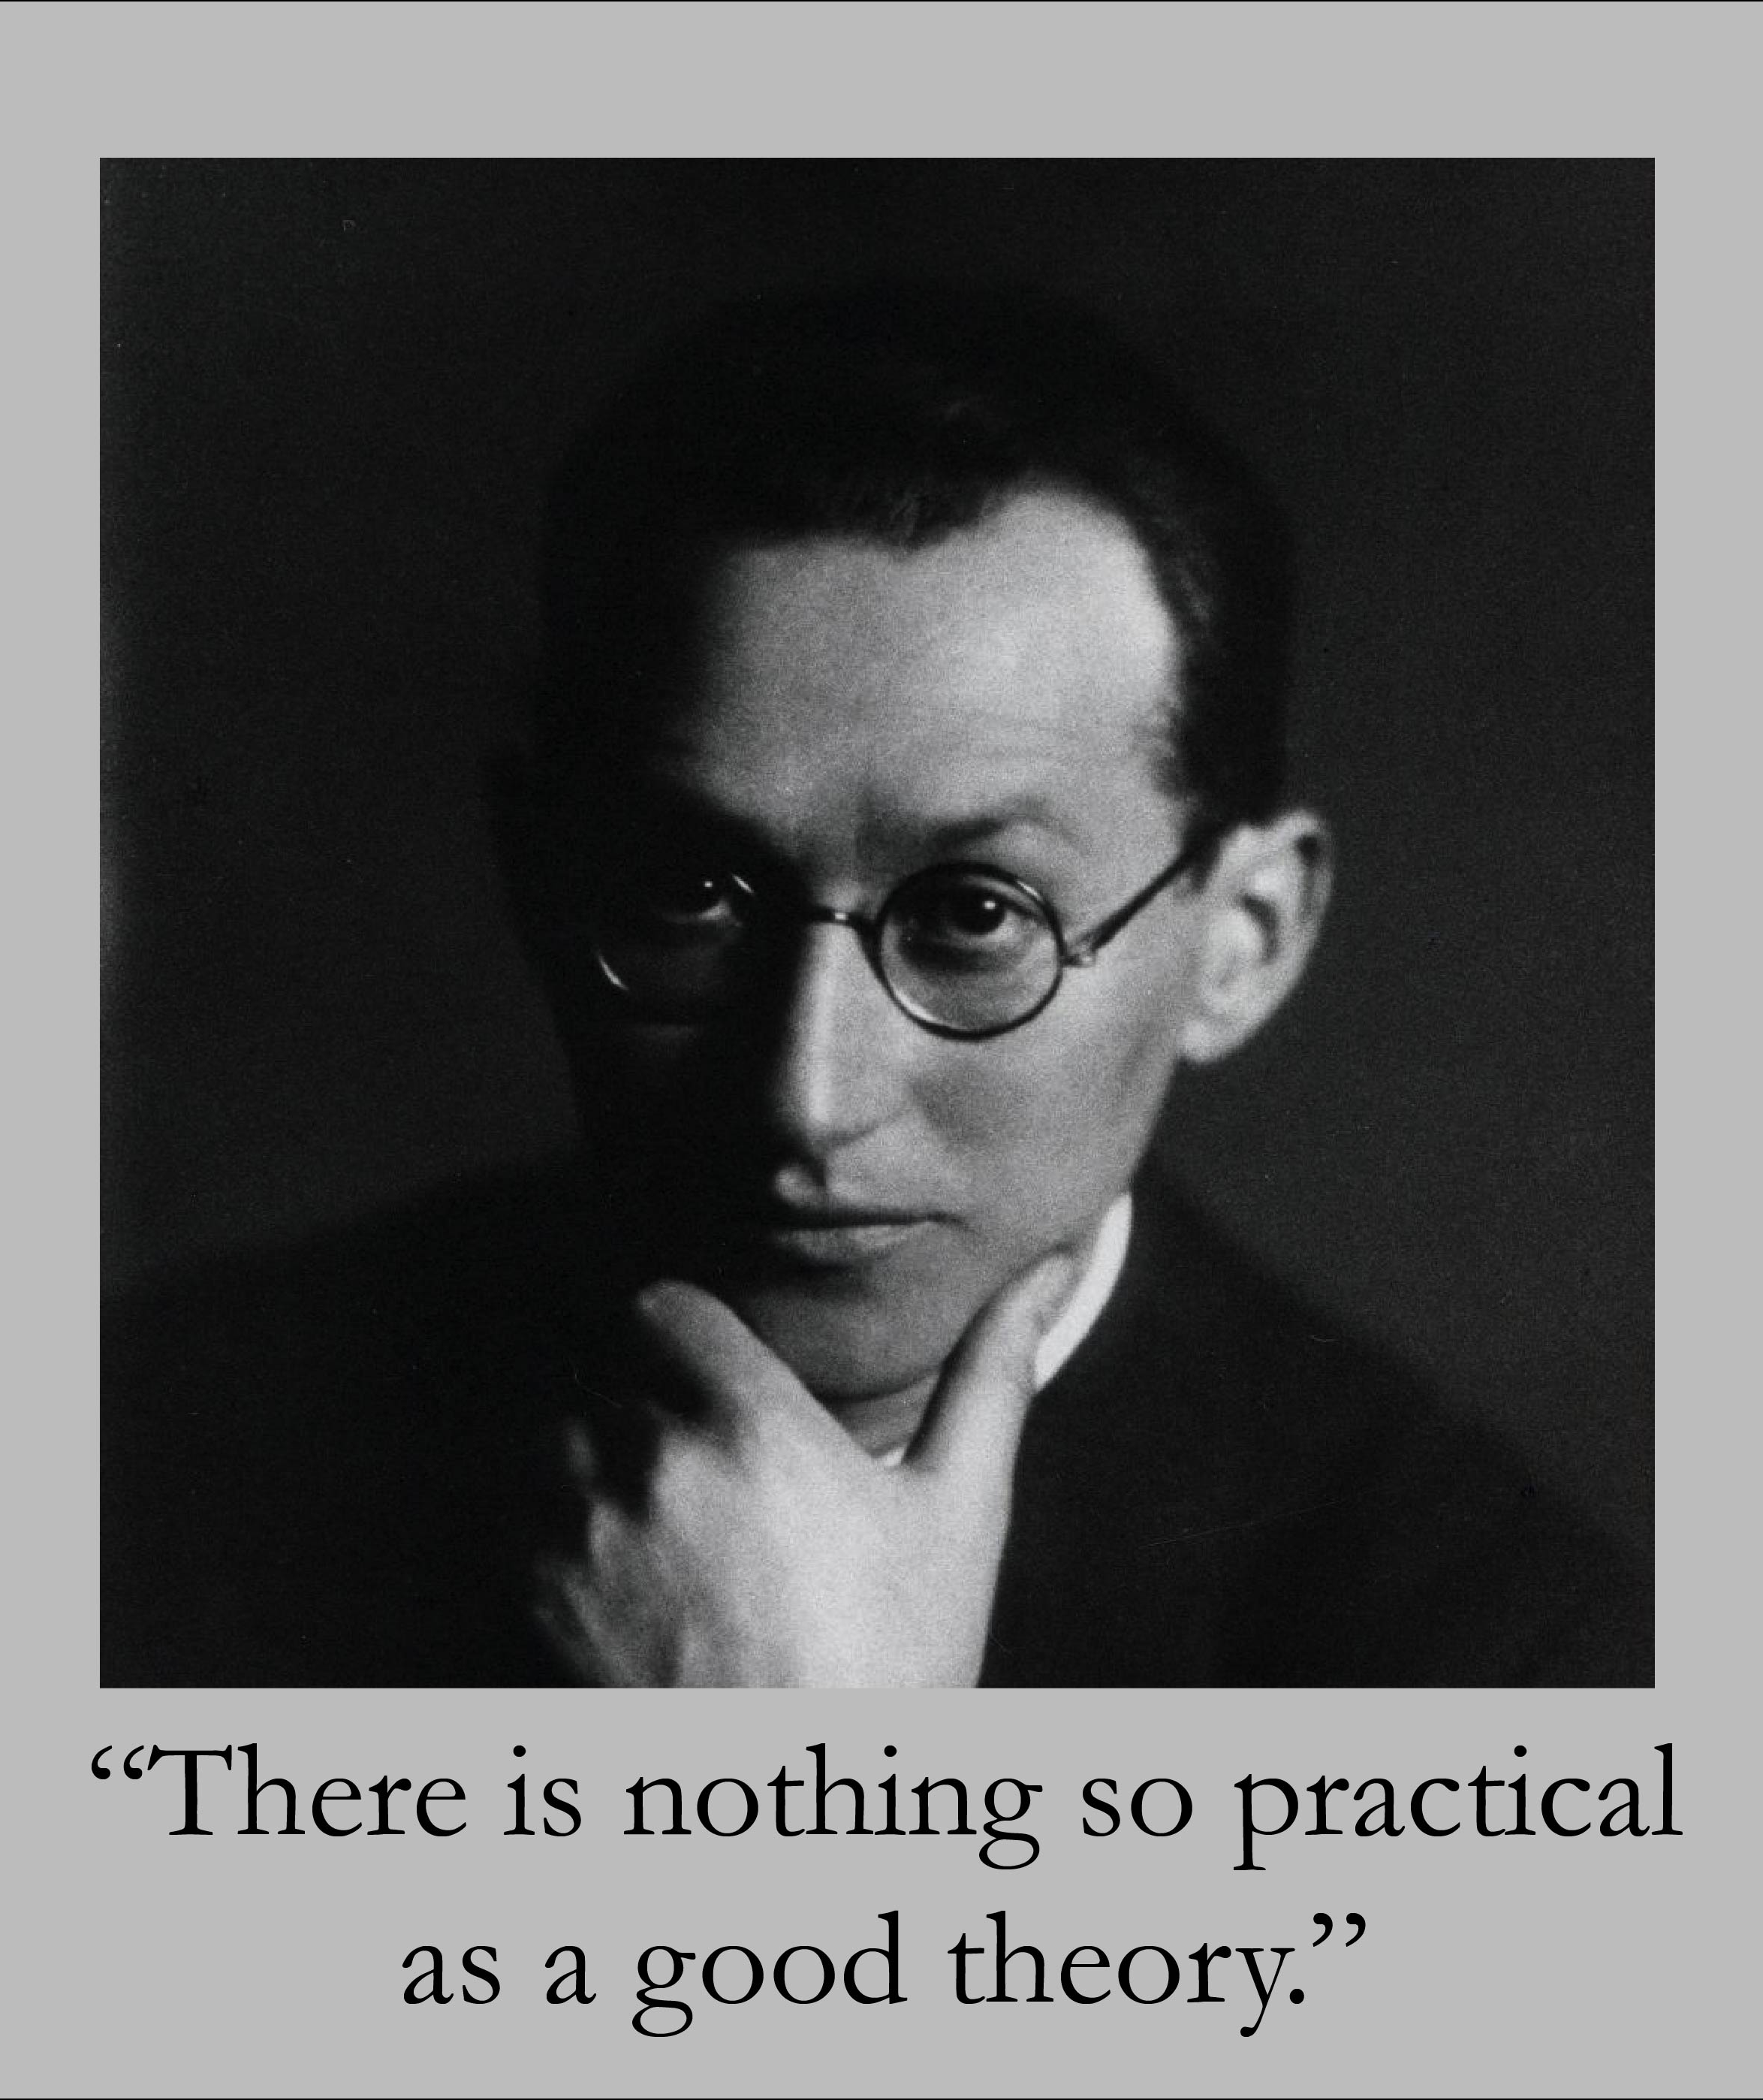
Lewin
“A change towards a higher level of group performance is frequently short lived, after a ‘shot in the arm’, group life soon returns to the previous level. This indicates that it does not suffice to define the objective of a planned change in group performance as the reaching of a different level. Permanency at the new level, or permanency for a desired period, should be included in the objective.” Lewin (1947:228)

Slide 41
Lewin’s Three-step Model
Unfreezing
Challenging the comfortable situation, creating dissatisfaction with current arrangements
Moving
Making the change, letting go of old ways, confusion and discomfort, taking on new work
Re-Freezing
Reinforcing and stabilising the new ways of working, evaluation results, making constructive adjustments
Source: Developed from Lewin (1951).
Notes:
Figure 9.3
Lewin’s three-step model

Slide 42
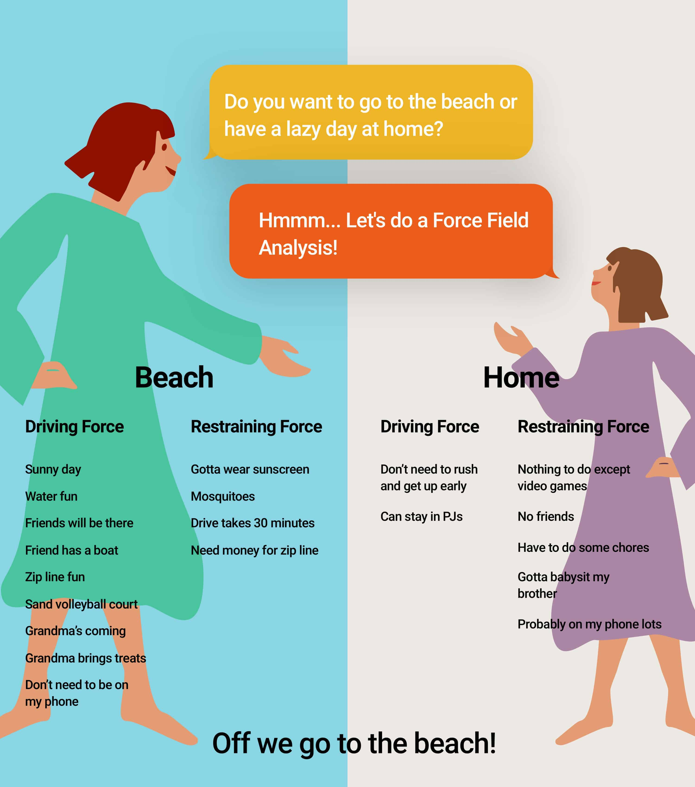
Force-field Analysis
https://blogs.masters.ab.ca/2018/force-field-analysis-summer-break/

Slide 43
Stage Models of Change Processes
Lewin (1951) | Kotter (1995) | Cummings and Worley (2001) | Ulrich (1998)
Unfreezing | Establishing a sense of urgency Forming a powerful guiding coalition Creating a vision Communicating the vision | Motivating change Creating a vision Developing political support | Leading change (Who is responsible) Creating a shared need (Why do it?) Shaping a vision (What will it look like when we’re done?)
Moving | Empowering others to act on the vison Planning for and creating short-term wins | Managing the transition | Mobilising commitment (Who else needs to be involved?) Mobilising systems and structures (How will it be institutionalised?)
Re-freezing | Consolidating improvements and creating still more change Institutionalising new approaches | Sustaining momentum | Monitoring process (How will it be measured?) Making it last (How will it get started and last?)

Slide 44

Planned Change Criticisms
Assumes environmental stability
Ignores power and politics
Too reliant on managers
Not applicable to situation that need rapid, directive, transformational change
It is a ‘one best way’ approach
Limited applicability
Burnes: Managing Change 4th edition, Pearson Education Limited, 2004

Slide 45

Emergent Change
Successful change is less dependant on plans and projections than on reaching an understanding of the complexities of the issues concerned and identifying the range of available options. (Pettigrew, 1997)

Slide 46

Emergent Approach to Successful Change
Organisation Structure
Organisation Culture
Organisation Learning
Managerial Behaviour
Power and Politics

Slide 47
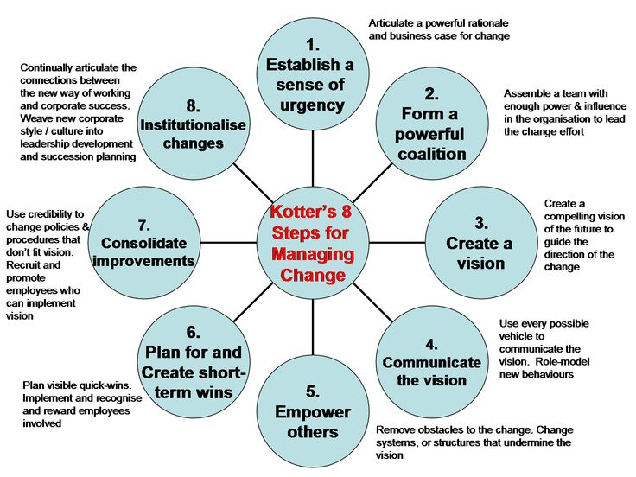
8-Step Change Model, Kotter (1996)

Slide 48


Emergent Change Processes
Advocates the need for continuous change, which emanates from the bottom of the organisation (Burnes, 2000; 2004)
Must take a dynamic approach
Requires devolved and timely decision making to respond to developments
Requires readiness for change
Requires involvement of a broad range of stakeholders across levels and positions
In comparison to planned approaches, lack coherence and diversity in techniques

Slide 49
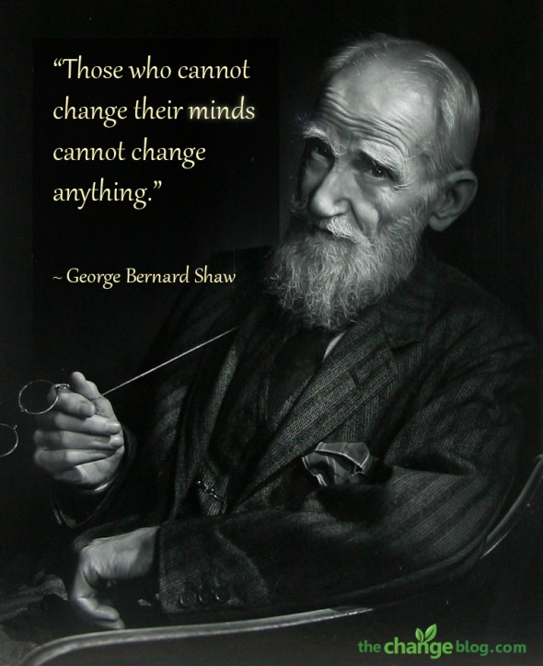
Emergent Change Criticism
“One best way”
Assumes all organisations are the same
Over focuses on power and politics
Culture treated as malleable
Ignores managerial resistance
Ignores choice
Burnes: Managing Change 5th edition, Pearson Education Limited, 2004

Slide 50

Emergent Approach Summary
Change is a continuous process
It involves experimentation, adaption and risk-taking
Incremental change leads to wholesale change
Managers must foster a climate of learning and experimental change
Managers must create collective vision for the organisation
Key organisational processes:
    Information gathering
    Communication
    Learning
  Burnes: Managing Change 5th edition, Pearson Education Limited, 2004

Slide 51
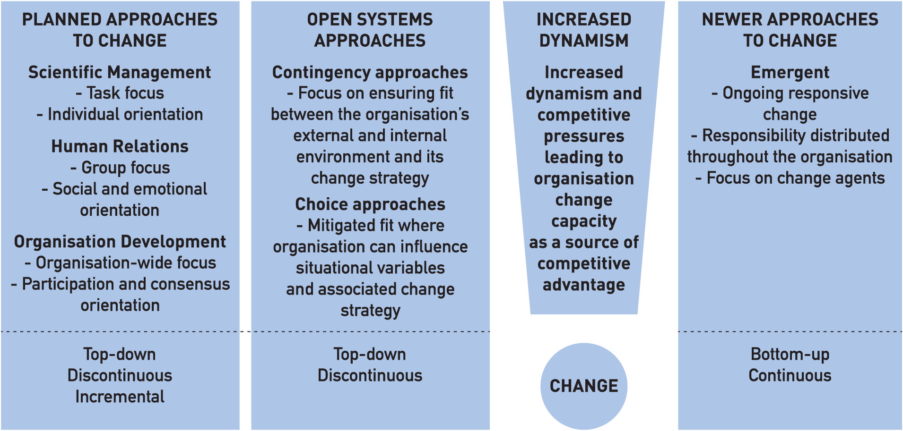
Change Models
Notes:
Figure 15.3 Summary of conceptions to change and approaches to how it should be managed

Slide 52
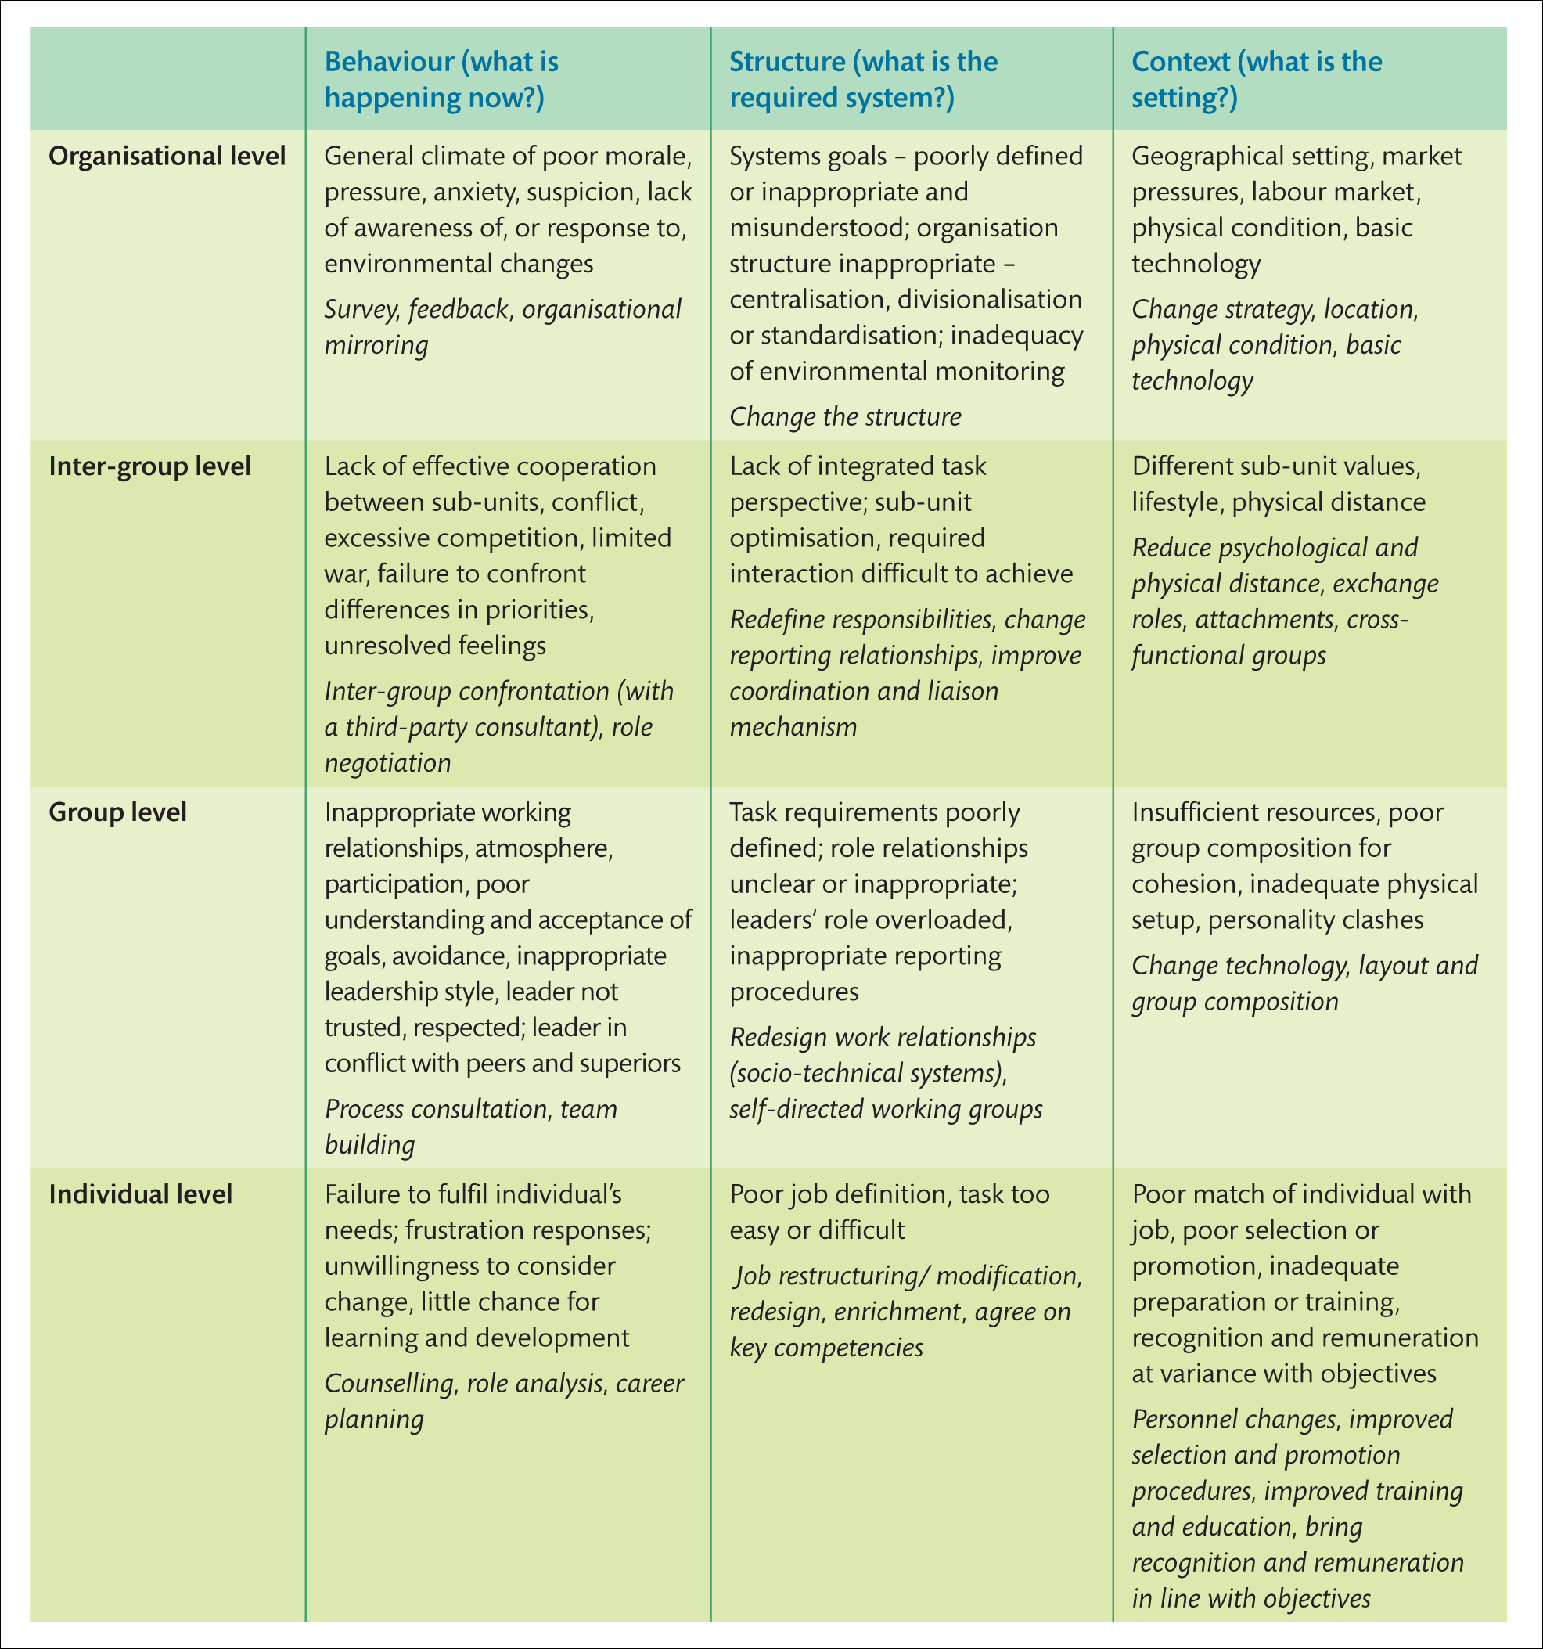
Organisational Developmental Matrix
Source: Pugh (2009).
Notes:
Table 9.2

Slide 53

Cornerstone 3: Change Agents
(‘Who’ makes change happen?)
‘All changes processes are influence processes. All influence processes require awareness of, if not action in, the political processes of the organisations’. (Pettigrew, 2000: 250)
Role adopted depends on the nature of the change
  Change agents or idea champions?
  Re-directing individuals?
  Dis-continuous change, re-framing and guiding coalitions?
Most Leaders Don't Even Know the Game They're In | Simon Sinek https://www.youtube.com/watch?v=RyTQ5-SQYTo
Change Management vs. Change Leadership — What's the Difference? John Kotter https://www.youtube.com/watch?v=2ssUnbrhf_U

Slide 54
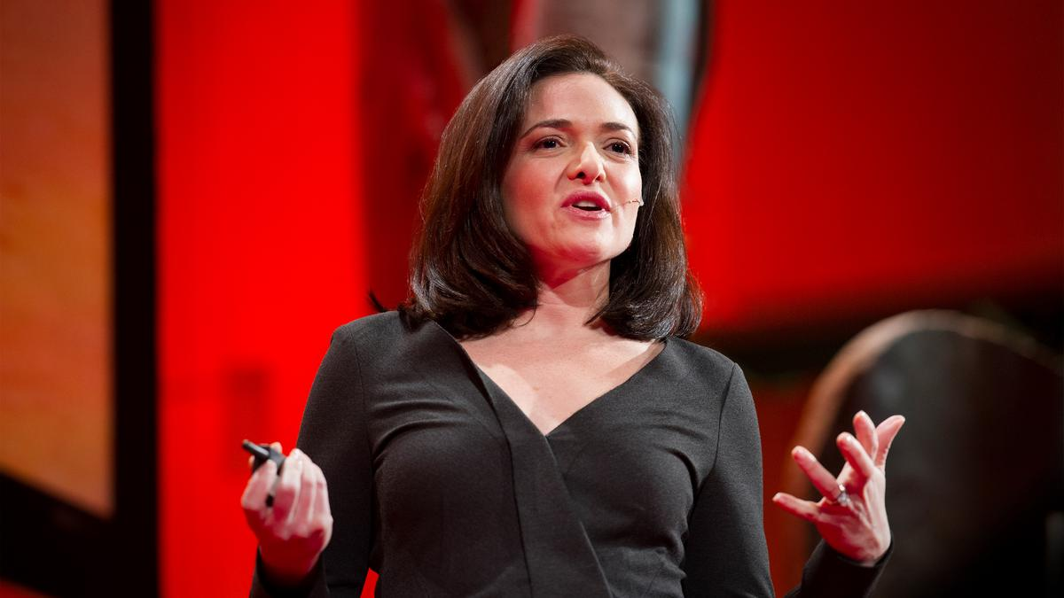
“True leadership stems from individuality that is honestly and sometimes imperfectly expressed… Leaders should strive for authenticity over perfection.” (Sheryl Sandberg) https://www.ted.com/talks/sheryl_sandberg_why_we_have_too_few_women_leaders

Slide 55
Sources of Power & Strategies for Change Agents
Individual Sources of Power
Power Strategies
Knowledge
Playing it Straight
Knowledge
Playing it Straight
Using Social
Networks
Others’ Support
Using Social
Networks
Others’ Support
Going Around the
Formal System
Personality
Going Around the
Formal System
Personality

Slide 56
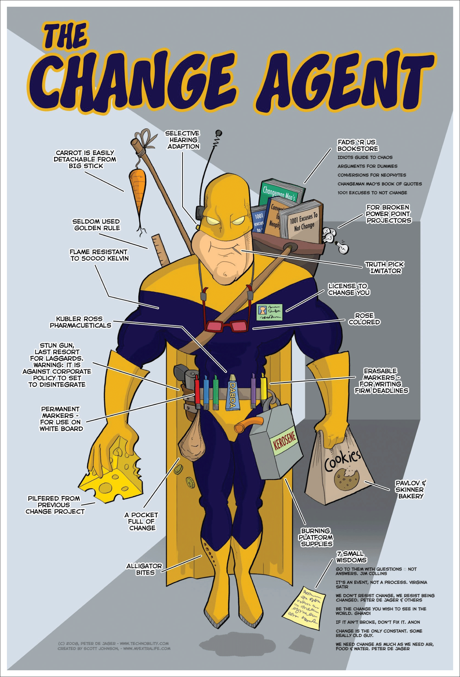
Change Agents
Change agents are individuals (or groups of individuals), from within or outside the organisation, who champion and guide organisational members towards change
  Leadership
    Change agents as senior figures, providing vision and charisma
  Management
    Change agents as middle managers supporting strategic change
  Consultancy
    Change agents as external or internal consultants, skilled in providing support or change
  Team
    Change agents as teams who can operate at all levels
Source: Peter de Jager (http://www.technobility.com/).

Slide 57
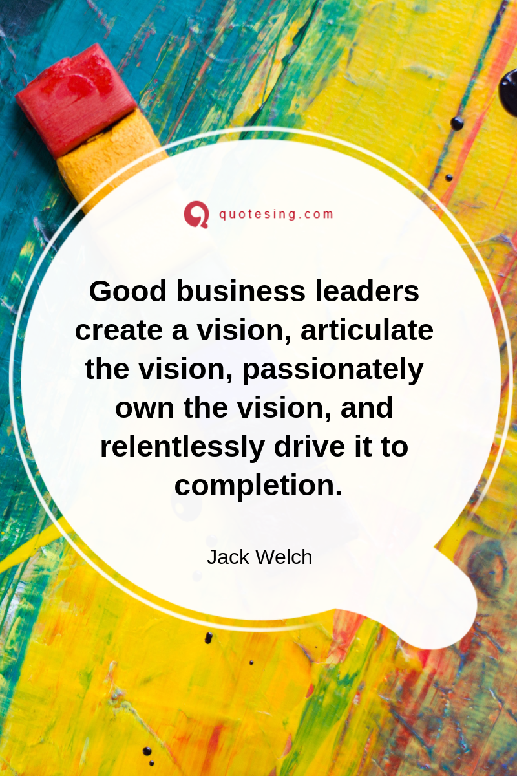
Leading & Managing Change
Material highly prescriptive, advising HOW to PLAN and IMPLEMENT
Traditionally, focus has been on RESISTANCE and ways to overcome it
Alternatively, more recent focus has been on
  Creating VISIONS and DESIRED FUTURES or
  LEARNING PRACTICES and LEADERSHIP BEHAVIOURS

Slide 58
Change Management Activities
Motivating Change
Creating Vision
Effective
Change
Management
Developing
Political Support
Managing the Transition
Sustaining Momentum

Slide 59

Motivating Change
Creating Readiness for Change
  Sensitize the organisation to pressures for change
  Identify gaps between actual and desired states
  Convey credible positive expectations for change
Resistance to Change
  Provide empathy and support
  Communicate
  Involve members in planning and decision making

Slide 60

Creating a Vision
Discover and describe the Organisation’s values
  What are the core values (the values in use) that inform members what is important in the organisation?
  What is the organisation’s core purpose or reason for being?
Construct the Envisioned Future
  What are the bold and valued outcomes?
  What is the desired future state?

Slide 61
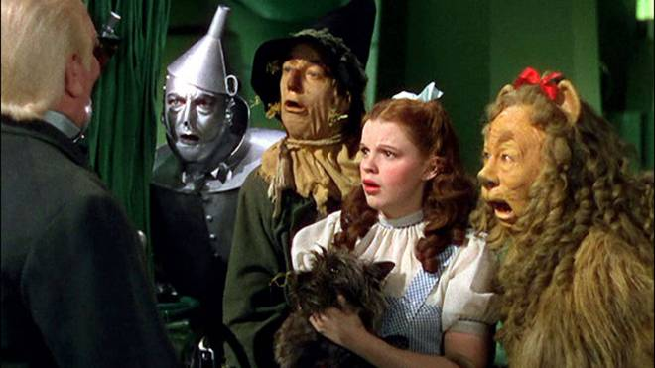
Developing Political Support
Assess Change Agent Power
    How to use it to influence others to support change
Identify Key Stakeholders
    Who stands to gain or lose from the changes?
Influence Stakeholders

Slide 62

Managing the Transition
Activity Planning
    What’s the “roadmap” for change?
  Commitment Planning
    Whose support is needed
    Where do they stand?
    How to influence their behavior?
Change-Management Structures
    What’s the appropriate arrangement of people and power to drive the change?

Slide 63

Sustaining Momentum
Provide resources for change
Build a support system for change Agents
Develop new competencies and skills
Reinforce new behaviors
Stay the course
“If your actions create a legacy that inspires others to dream more, learn more, do more and become more, then, you are an excellent leader.” Dolly Parton

Slide 64
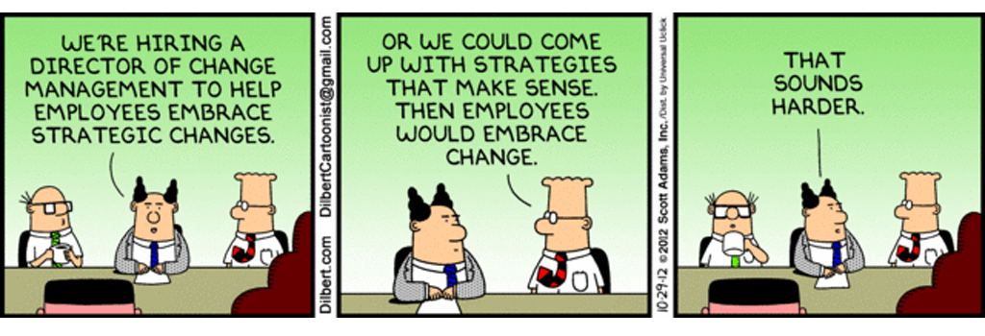
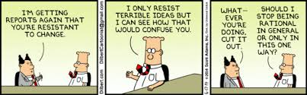
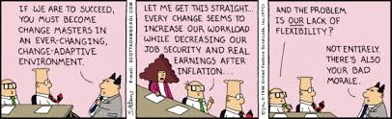
Cornerstone 4: Change Recipients
(‘Who’ is affected by change and how can they be supported?)
Claims that employees’ reactions to change have been largely neglected (Bartunek et al., 2006; Judge et al., 1999)
Change recipients can display affective, cognitive and behavioural reactions (Oreg et al., 2011)
Behavioural reactions include
  Acceptance/compliance (Iverson, 1996)
  Ambivalence (Piderit, 2000)
  Resistance (Oreg et al., 2011)

Slide 65
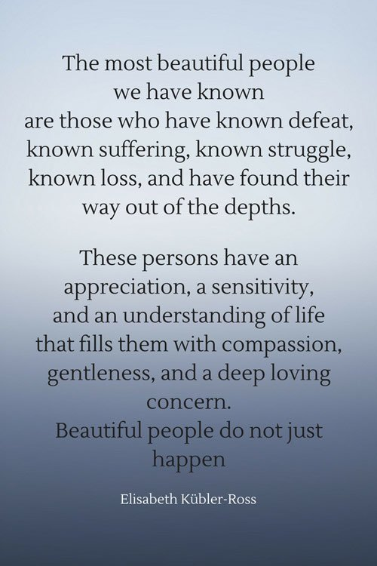
Individual Change Management
(Elisabeth Kubler-Ross)
Five Stages of Grief
  Denial
  Anger
  Bargaining
  Depression
  Acceptance
Organisational Terms
  ‘Coping Cycle’
  DERC

Slide 66
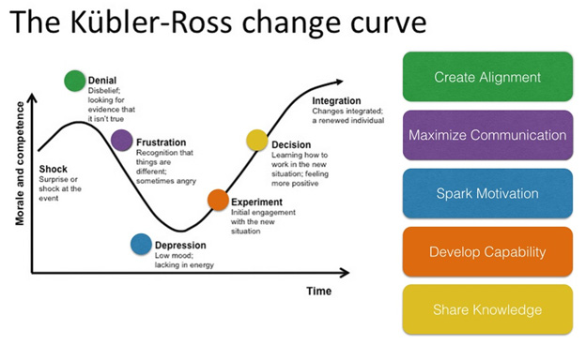
DREC (Ask & Tell)
Denial
  Not me! (Tell)
  Specific instructions, to tell what to do next
Resistance
  Not Now? (Ask)
  What are you going to do next?
Exploration
  What About? (Tell)
  Looking to the future
    Danger of trying to do everything
    Overloaded
  Tell the individual to choose their focus
Commitment
  Lets do it! (Ask)
  Asking to learn - what they will do next
Takes time to work through the cycle, don’t hurry. If pressurized can revert back to denial (Tarzan Swing)

Slide 67
Creating Preparedness for Change
Attitudinal & Behavioural Perspectives
Focus | Definition
Readiness for Change | ‘An individual’s beliefs, attitudes, and intentions regarding the extent to which changes are needed and the organisation's capacity to successfully undertake those changes’ (Armenakis, Harris and Mossholder, 1993:681)
Openness to Change | ‘Positive affect about the positive consequences of change’ (Miller, Johnson and Grau, 1994:60)
Commitment to Change | ‘A mindset that binds an individual to a course of action deemed necessary for the successful implementation of a change initiative’ (Herscovitch and Meyer, 2002:475). This mindset can take different forms: A desire to provide support for the change based on a belief in its inherent benefits (affective commitment to change) A recognition that there are costs associated with failure to provide support for the change (continuance commitment to change) A sense of obligation to provide support for the change (normative commitment to change)
Coping with Change | ‘Cognitive and behavioural efforts to deal with experiences that tax or exceed one’s resources’ (Folkman et al,.1986:993)
Notes:
Table 15.1 Preparedness for change:
attitudinal and behavioural perspectives

Slide 68
Creating Preparedness For Change
Attitudinal & Behavioural Perspectives
Explain pressures for change
1
Communicate discrepancies between current and desired states
2
Convey credible positive expectations
(Cummings and Worley, 2001)
3
Need high level of participation and support
4
Open communication
5
Competent management
6
Overall sense of fairness
7
(Axtell et al., 2002; Conway and Monks, 2008; Oreg et al., 2011)

Slide 69

Managing & Celebrating
Resistance to Change
Participation and involvement
Facilitation and support
Negotiation and agreement
Political approaches
Explicit and implicit coercion
(Kotter and Schlesinger, 2008)
Productive resistance
  Enabling change recipients to add value to change processes through conceptual expansion, innovation and the generation of new knowledge
“We are the Borg. You will be assimilated. Resistance is futile” The Borg: Star Trek

Slide 70
Change Management Roles
Potential HR Contributions | Change Drivers/Change Processes | Change Agents | Change Recipients
Unfreezing – creating readiness and preparedness for change | Diagnosing problems/challenges/opportunities Embedding change in managing agendas across the organisation Developing a change strategy/to adapt to new conditions Informing, communicating and consulting with employees and employee representatives Identifying key stakeholders and opinion leaders | Training in building evidence based skills for improvement Supporting the development of material for information and consultant sessions Providing communications training Selecting change agents for skills, knowledge, aspirations and resilience | Selecting individuals capable of coping with change Facilitating information, communication and consultation sessions
Moving – supporting the transition | Using change tools to diagnose the likelihood of successful change, gaps and supporting interventions Identifying workforce implication and appropriate supports Developing specific interventions to deliver change Identifying and responding to problems in the change process | Helping to generate change related skills e.g. training in improvement methods Providing change resources Establishing peer networks to support and spread change | Hosting workshops to identify implications of the change for individuals and their roles Training in new ways of doing things Counselling Outplacement support where required
Refreezing – helping to embed in practice | Celebrating and promoting improvements Recognising those involved in delivering change Embedding structural changes and new lines of reporting Redesigning HR processes and practices to support new status quo | Supporting manager across levels and identifying implication of the new status quo for policies and practices | Providing local evidence of the benefit of the change
Ongoing change – related roles | Process mapping Analytics to generate evidence of impact | Supporting in managing workload and stress Career and succession planning | Support in managing workload and stress Career planning support
Notes:
Figure 15.5 Potential HR roles in change

Slide 71
Toolkit
(Armstrong, 2017)
Process Consultation
Helping clients to generate and analyse information they can understand and, following a thorough diagnosis, act upon.
Information will relate to organisational processes such as:
Change Management
Often using the techniques advocated by Lewin (1951) which consisted of processes of managing change by
Action Research
Collecting data from people about process issues and feeding it back to identify problems and their likely causes as a basis for an action plan to deal with the problem
Survey Feedback
A variety of action research in which data is systematically collected about the system through
Group Dynamics
Improving the ways in which people work together by means of programmes which aimed to increase the effectiveness of groups through various forms of training, e.g.
Personal Interventions
Developing interpersonal skills through such processes as:
Later method, neuro-linguistic programming or NLP (teaching people to programme their reactions to others and develop unconscious strategies for interacting with them)
Transactional analysis (an approach to understanding how people behave and express themselves through transactions with others)
Behaviour modelling (the use of positive reinforcement and corrective feedback to change behaviour
Team building
Interactive skills training
T-groups (‘training groups’ which aim to increase sensitivity, diagnostic ability and action skills)
Attitude surveys and workshops
Unfreezing, changing and freezing
Force-field analysis (analysing and dealing with the driving forces which affect transition to a future state)
inter-group relations
Leading to action plans
interpersonal relations
communications

Slide 72
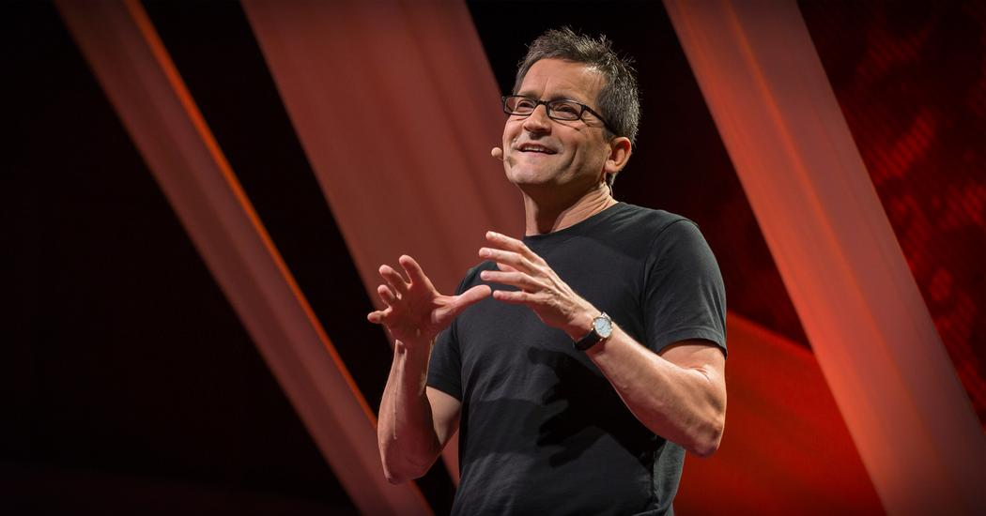
https://www.ted.com/talks/jim_hemerling_5_ways_to_lead_in_an_era_of_constant_change

Slide 73

Conclusion
In the change management literature, there remains ‘an unfortunate state of affairs where the waxing and waning of organisational improvement remedies are associated with limited understanding about what works and what does not and why’ (Tichy, 1983: 363)
However, there is consensus in the literature around the need to develop and harness the full change capability of organisations and their employees
“There is nothing permanent except change.”
Heraclitus (Greek philosopher, c. 535 BCE-c. 475 BCE)

Slide 74
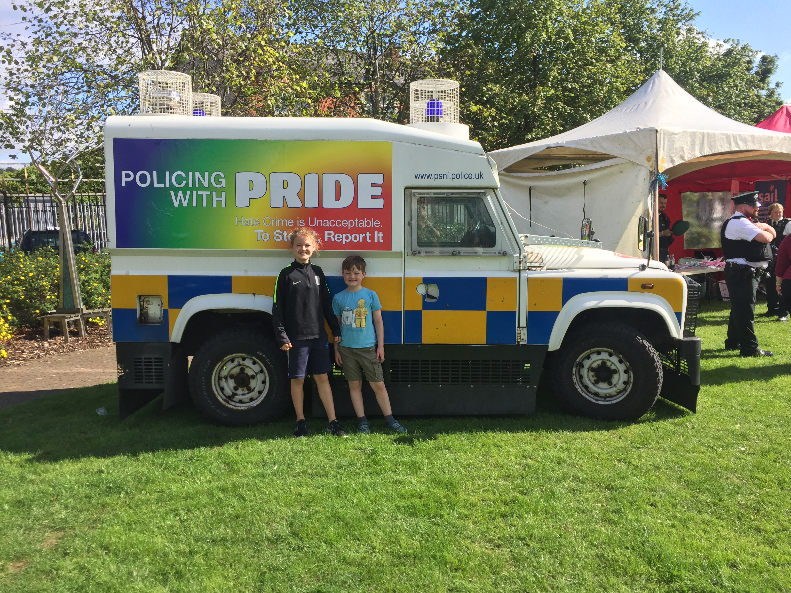
Change
Change
LOTR The Two Towers - The Tales That Really Mattered... https://www.youtube.com/watch?v=k6C8SX0mWP0

